Slide 1
Data Analysis of Immigrants received Since 1980
Analysis performed in Python Programming Language
By Joel Sandé

Slide 2
Warning :
Numbers in this presentation are completely FALSE.
I just wanted to highlight, from a practical case, the power of analysis of the Python language and its ability to generate results in visual form.
I will leave a link to download the csv file from where the data are drawn. The code will be available upon request from sandejoel@yahoo.ca (Free if you are a student taking my course, or a government representative).

Slide 3
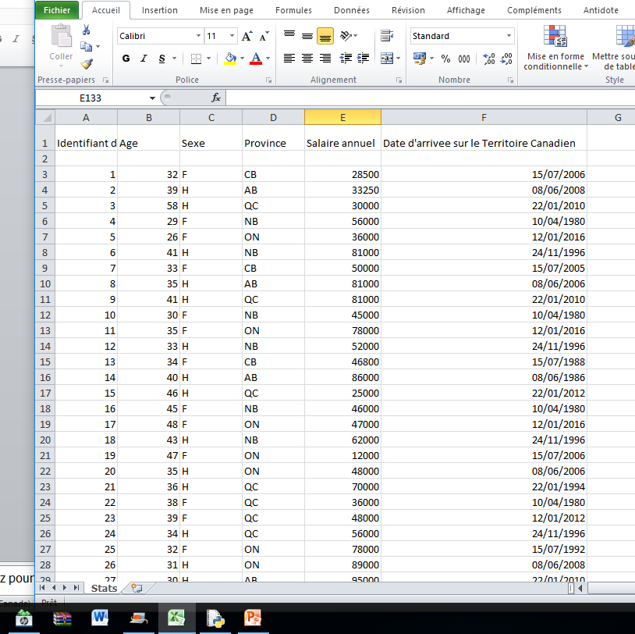
Stats.csv
Here is the content of the csv file used to make these analyzes

Slide 4
Overview
Introduction
Analysis Methodology
Small queries (Fonctions)
Number of records by province for a given yea.e
Number of women who have immigrated since 1980 in a given province, whose current annual salary is $ 45,000 or more
Big-Queries
Statistics of Total Registration Numbers by Province from 1980 to 2016
Statistics for all provinces of the 2nd small request.
Personnalization
Conclusion

Slide 5
Introduction
Canada is a country that was built on cultural diversity since the 1980s.
Many immigrants looking for a more stable geo-political environment immigrate to Canada.
I gave myself the mandate to do a complete analysis of the recorded data of these migrants.
I thank you for following me throughout my analysis . The source code is made in Python language. Let us start …

Slide 6
Analysis Methodology
By habit, I like to make small queries (Functions) for warm-up: It is therefore by this that we will start.
In general, when these queries are established, for the future, when one has to do with larger queries, simply go search them one by one or even combine them to facilitate the task during a large query.
It becomes a game of boys, and the code is easier to maintain. Let’s start …

Slide 7
Statistics of Total Registration Numbers by Province from 1980 to 2016

Slide 8
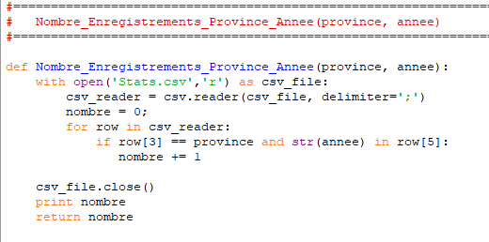
Small Queries
1) In preparation for a large query that spans all years of registration, we will create a small function
Nombre_Enregistrements_Province_Annee('NB', 1996)
The answer for this query is 3

Slide 9
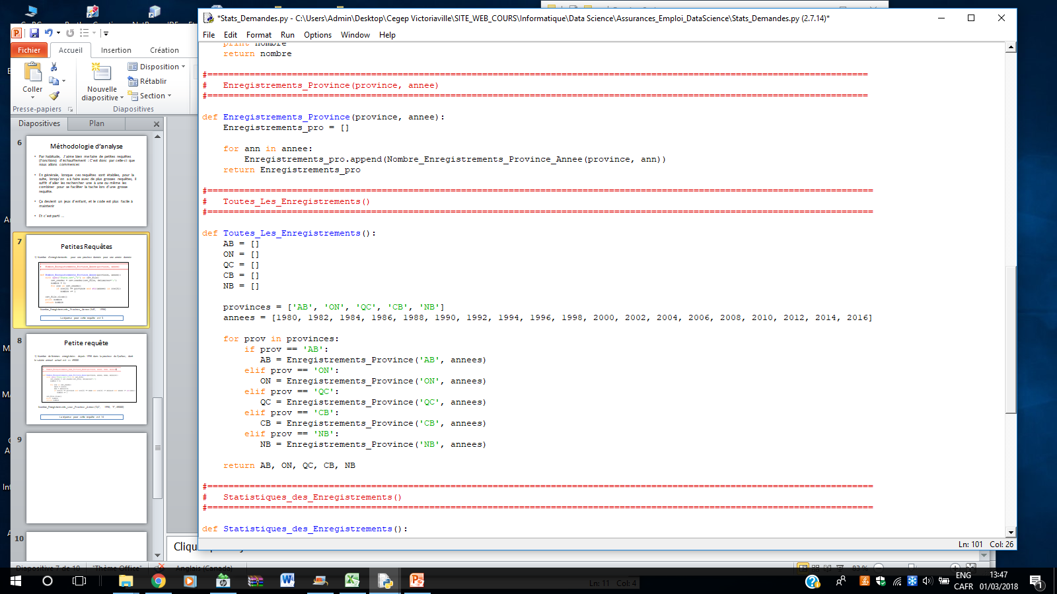
Small Queries
In preparation for a large query that deals with all years of registration, we will create a small function that stores in a table all records for a given province from the year 1980 to 2016

Slide 10
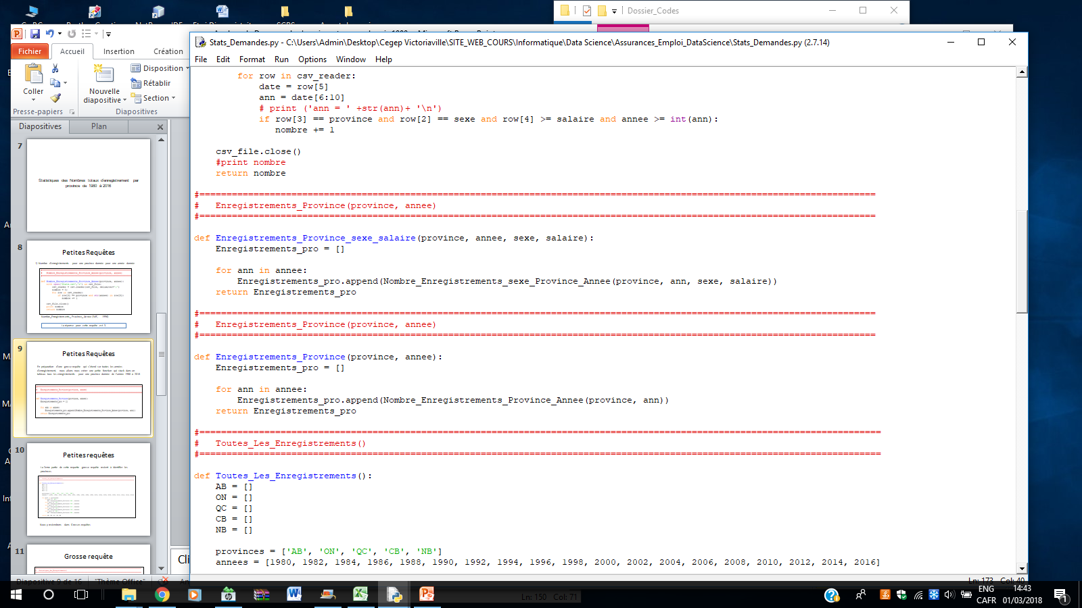
Small Queries

Slide 11
Petites requêtes
The second part of this big request is to identify the provinces.

Slide 12
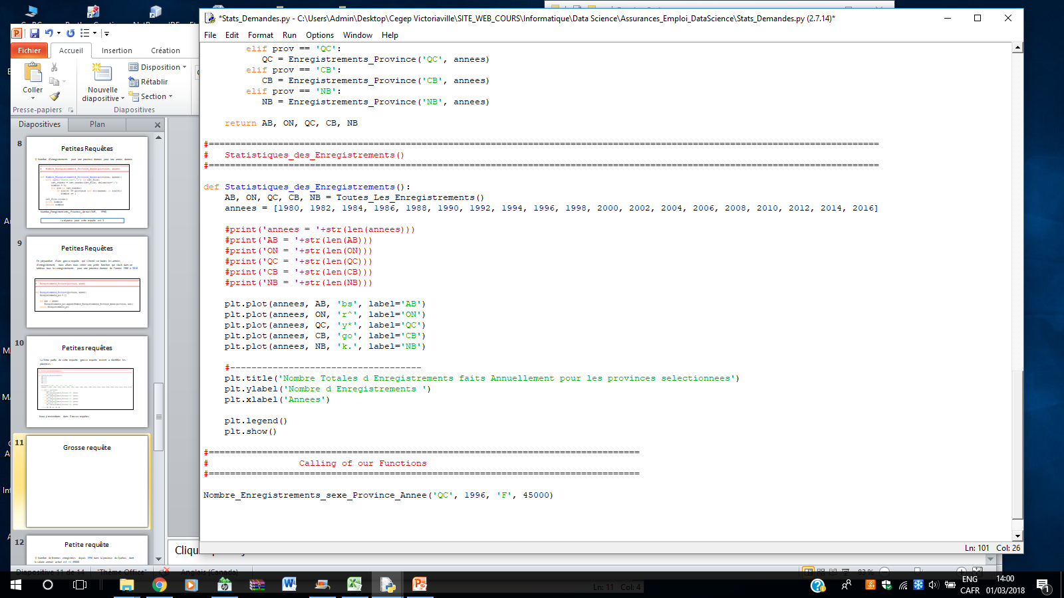
Big Query

Slide 13
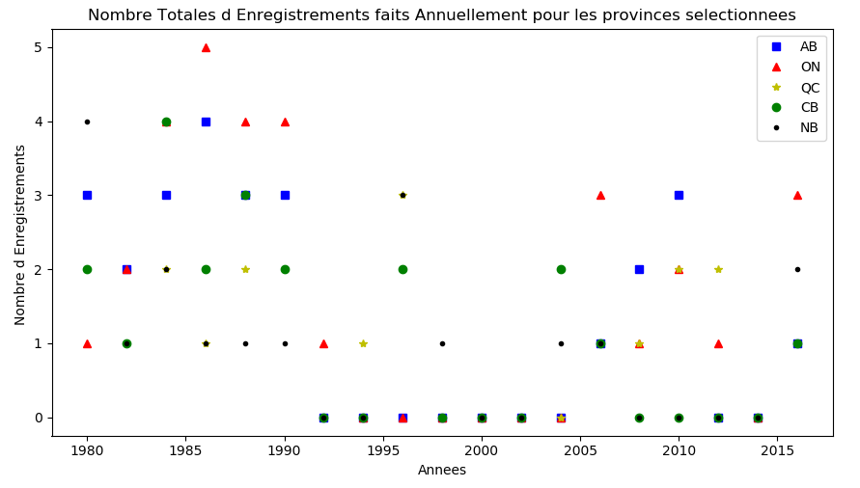
Visualization

Slide 14
Statistics of Number of women who have immigrated since 1980 and whose current annual salary is >= 45,000

Slide 15
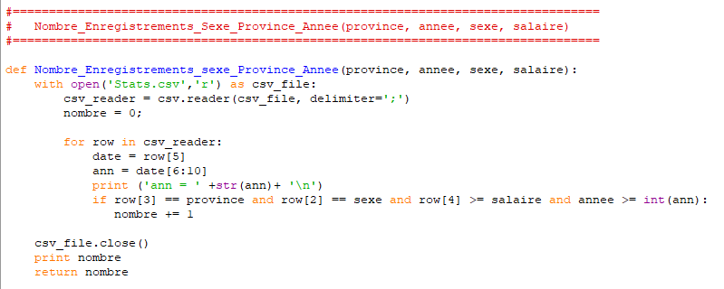
Small Query
1) Statistics of Number of women who have immigrated since 1980 and whose current annual salary is?> = 45,000
Nombre_Enregistrements_sexe_Province_Annee('QC', 1980, 'F', 45000)
The answer for this query is 14

Slide 16
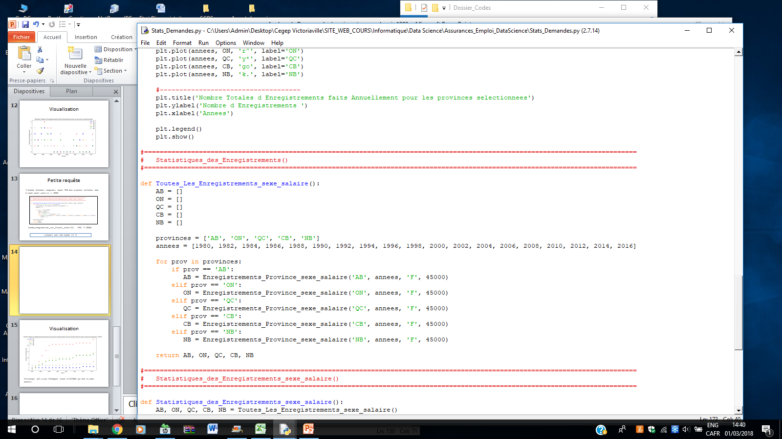
Small Query

Slide 17
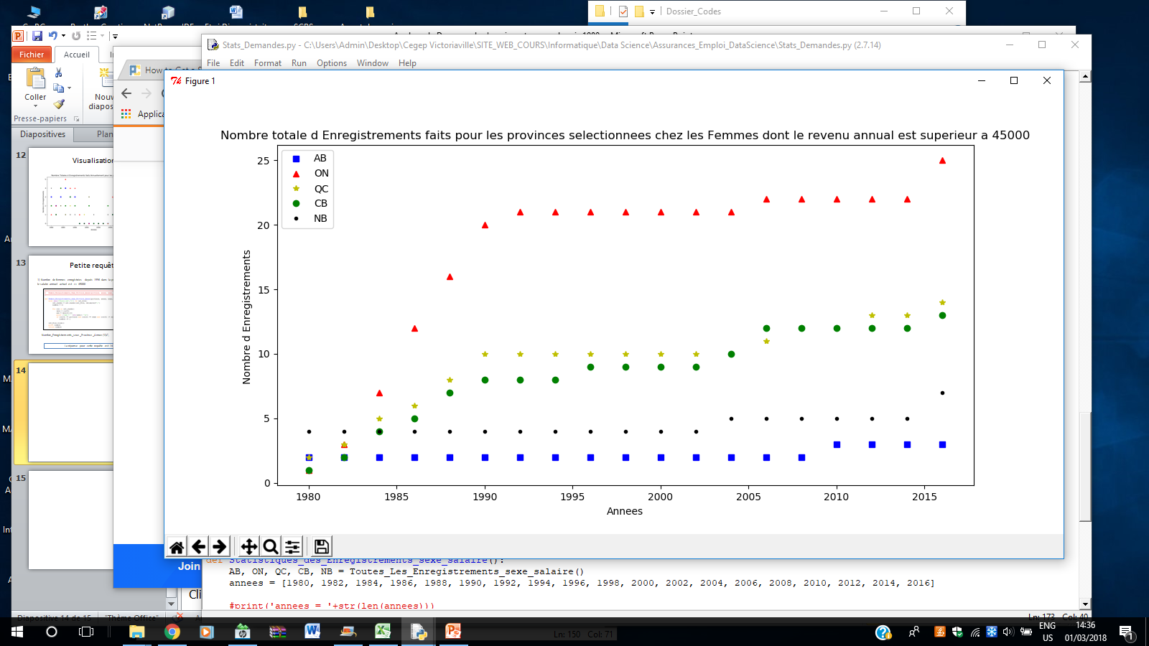
Visualization
Note that there are more immigrants coming to ONTARIO than in other provinces

Slide 18
Personnalisation
We can even customize the 2nd request:
Vary the years of the request
Decide whether it's either men's or women's statistics or even both
Choose the desired salary
…

Slide 19
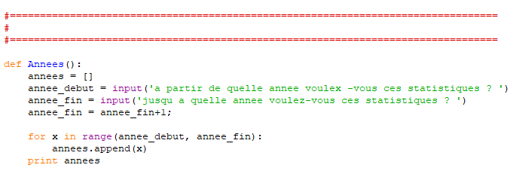
Small Query
1) Vary the years of the request

Slide 20
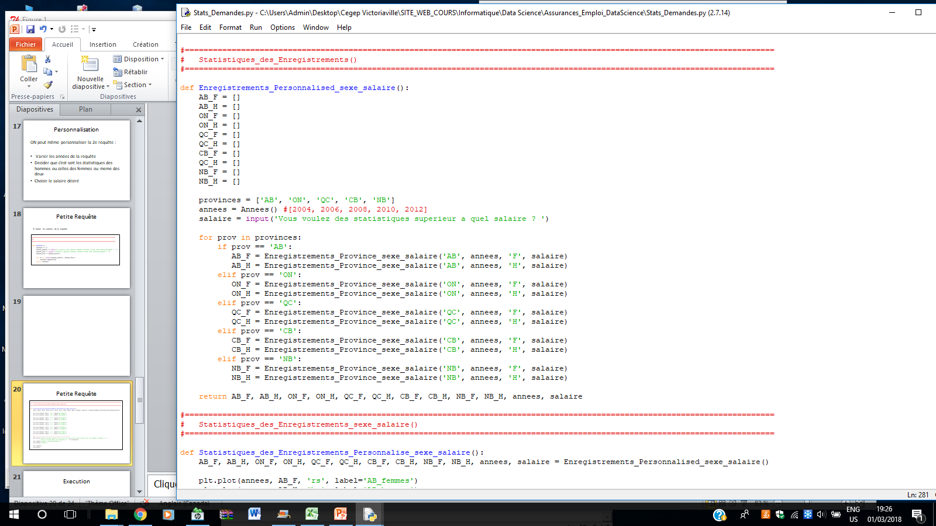
Small Query
2) Produce statistics of men and women,
3) Input the starting salary of your choice

Slide 21
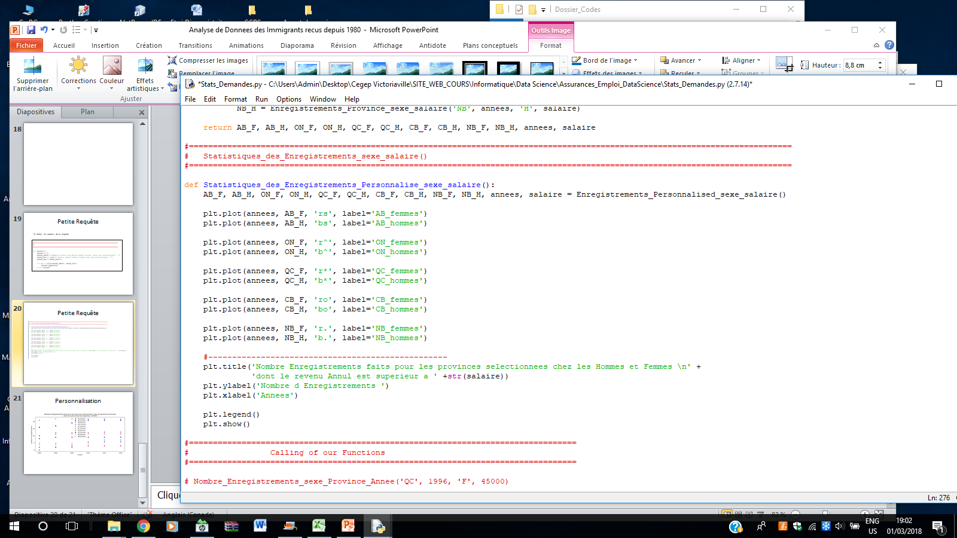
Big Query

Slide 22
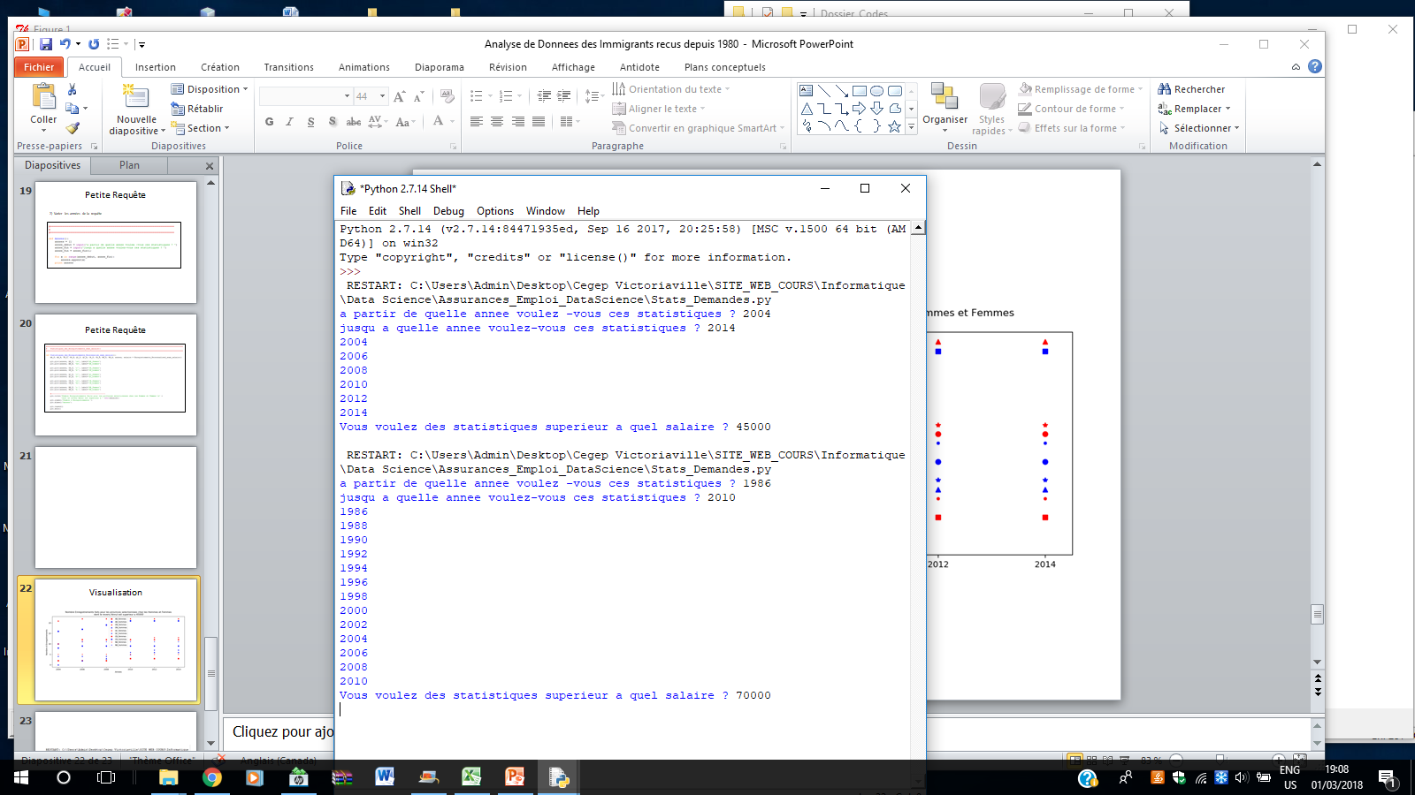
Execution

Slide 23
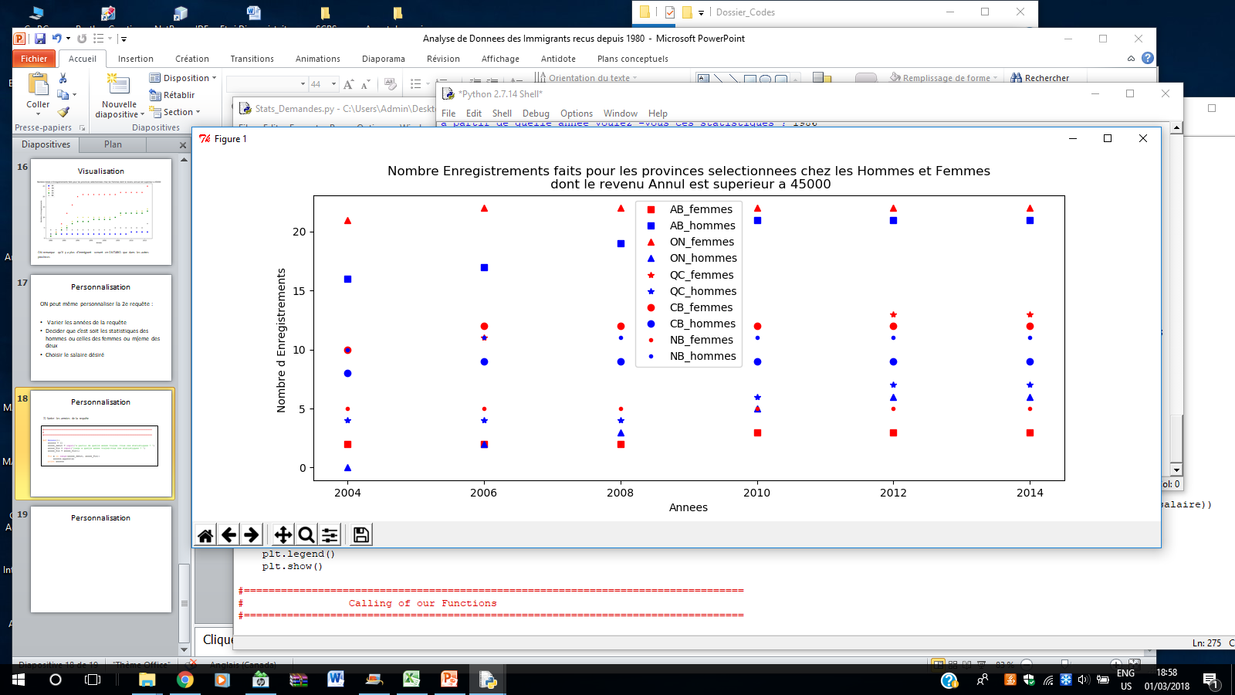
Visualization

Slide 24
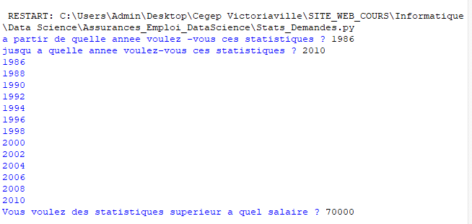
Execution

Slide 25
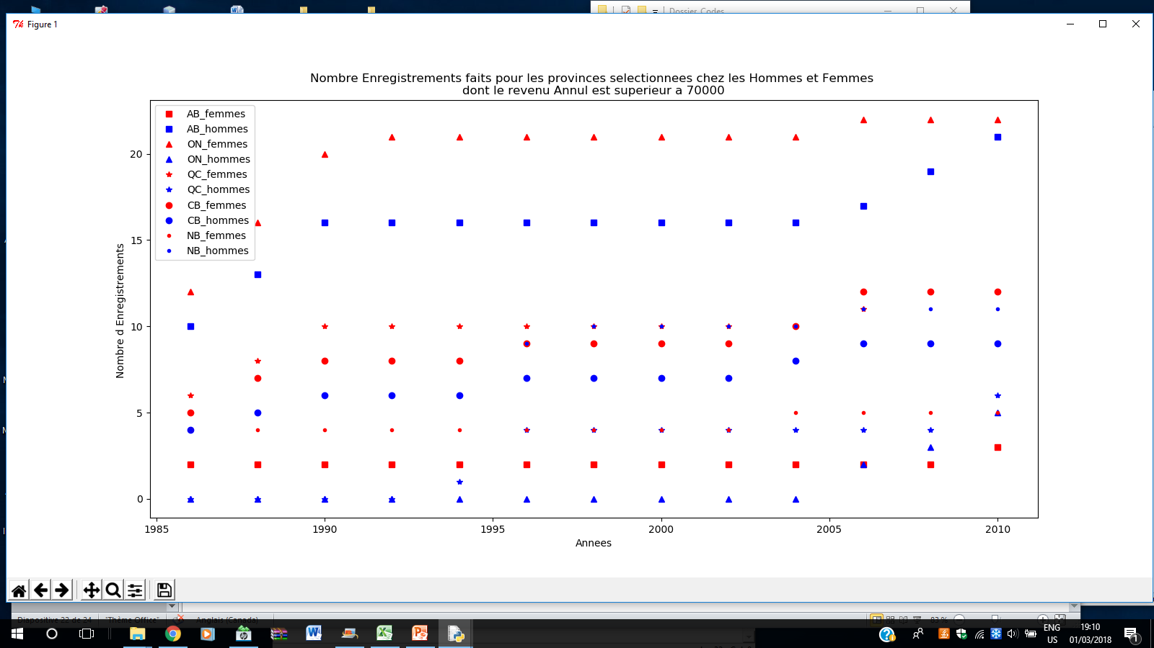
Visualization

Slide 26
Small additional request
It is not always required to do sub-queries.
We can do courses with 2 nested loops.
This is the case if we want to see the average salary by province.

Slide 27
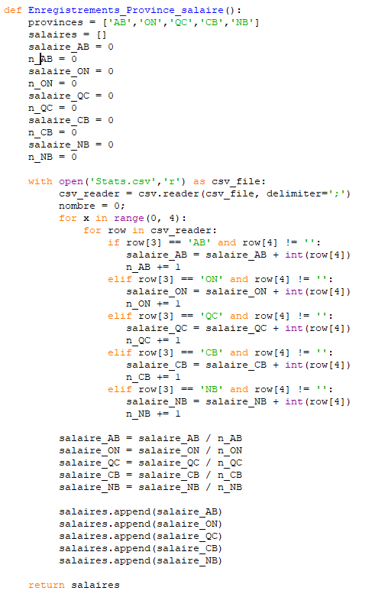

Slide 28
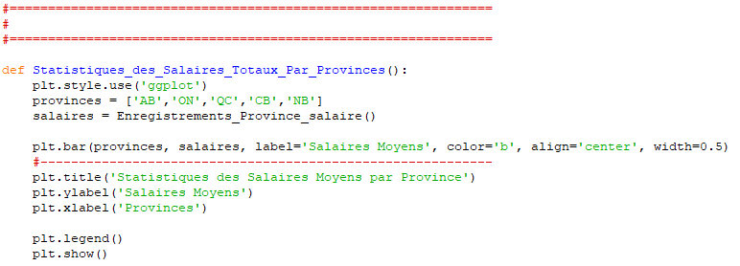

Slide 29
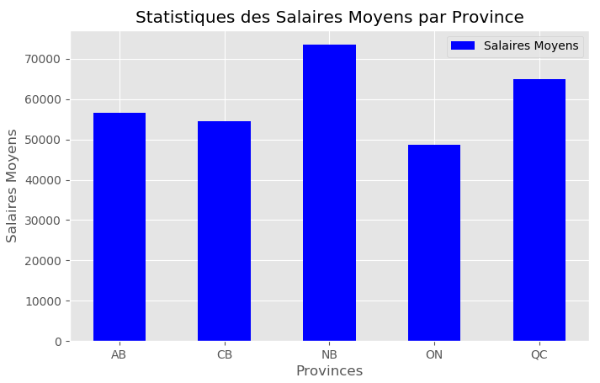
Visualisation
Results show that : NB > QC > AB > CB > ON

Slide 30
Thank you for following me in this adventure of DataSciences
Contact me at sandejoel@yahoo.ca
for questions

